Slide 1

























SPK ACADEMY
2024
+91 8838552428
contact@spkadvisory.com
www.spkadvisory.com
First Floor, Plot No.2, Thilak Nagar, Madurai Road, Junction, Tirunelveli – 627001

Slide 2
Introduction to Embedded Systems

Slide 3
What is an Embedded System?
An embedded system is a microprocessor-based computer system, designed to perform a specific function or task within a larger system.
Key Characteristics:
• Real-time performance
• Specific functionality
• Low power consumption
• Small size

Slide 4
Components of an Embedded System
Main Components:
• Processor: CPU or Microcontroller
• Memory: RAM, ROM, Flash
• Input/Output: Sensors, Actuators, Displays, etc.
• Software: Embedded firmware that controls hardware

Slide 5
Types of Embedded Systems
Based on Performance:
• Small Scale: Simple tasks, low power, e.g., digital watches
• Medium Scale: Complex applications, e.g., home appliances
• Sophisticated: High-performance systems, e.g., automotive control
Based on Functional Requirements:
• Real-time: Time-bound tasks, e.g., airbag systems
• Stand-alone: Independent, e.g., MP3 players

Slide 6
Applications of Embedded Systems
• Consumer Electronics: Smartphones, Cameras
• Automotive: ABS, Engine Control Units (ECU)
• Medical Devices: Pacemakers, MRI Machines
• Industrial Automation: Robotics, CNC Machines
• Aerospace: Flight Control Systems

Slide 7
Microcontroller vs Microprocessor
• Microcontroller: Contains CPU, memory, and I/O ports in a single chip. Cost-effective for specific tasks. Common in real-time control systems.
• Microprocessor: CPU only, external memory, and I/O ports. More powerful, used in general-purpose computing. Common in PCs and servers.

Slide 8
Real-Time Embedded Systems
Definition: Systems that require predictable and timely responses to inputs.
Types:
• Hard Real-Time: Strict timing constraints, failure can cause catastrophic consequences, e.g., aircraft control systems.
• Soft Real-Time: Timing is important but not critical, e.g., multimedia systems.

Slide 9
Design Challenges
• Power Consumption: Optimizing energy use
• Real-time Constraints: Meeting deadlines
• Memory Constraints: Efficient use of limited resources
• Security: Protecting from external threats
• Cost: Balancing performance and expense

Slide 10
Development Tools
• Integrated Development Environment (IDE): e.g., Keil, MPLAB
• Compilers: Converts code into machine language
• Simulators/Emulators: Testing systems without physical hardware
• Debuggers: Identifies and fixes issues in the code

Slide 11
Future Trends in Embedded Systems
• Internet of Things (IoT): Network of interconnected devices
• Artificial Intelligence (AI): Embedded AI for decision-making
• Low Power and Green Computing: Focus on energy efficiency
• Wearable Technology: Embedded systems in health and lifestyle gadgets

Slide 12
Conclusion
• Embedded systems are the backbone of many modern devices, driving innovation in various fields.
• Future developments will further enhance the role of embedded systems in our daily lives.

Slide 13
Linux Fundamentals
A Beginner's Guide
Linux Fundamentals

Slide 14
Introduction to Linux
What is Linux?
Open-source operating system
Highly customizable and versatile
Used in various environments (servers, desktops, embedded systems)
Key Features:
Multi-user and multi-tasking
Command-line interface (CLI)
Strong security
Free and open-source

Slide 15
Linux Distributions
What is a Distribution?
A specific version of Linux with a particular package set and configuration
Popular Distributions:
Ubuntu
Debian
Fedora
CentOS/RHEL
Arch Linux
Choosing the Right Distribution:
Consider your needs and experience level

Slide 16
The Linux Filesystem
Hierarchical Structure:
Root directory (/)
Directories and files
Common Directories:
/etc: configuration files
/var: temporary data
/home: user directories
/usr: programs and libraries
File Permissions:
Read, write, execute
Owner, group, others

Slide 17
: The Command Line Interface (CLI)
Basic Commands:
ls: list files and directories
cd: change directory
mkdir: create a directory
touch: create a file
rm: remove a file
mv: move or rename a file
cp: copy a file
Shell:
Bash (default)
Zsh
Fish

Slide 18
Package Management
What are Packages?
Pre-built software bundles
Package Managers:
apt (Debian/Ubuntu)
yum (CentOS/RHEL)
dnf (Fedora)
pacman (Arch Linux)
Installing and Removing Packages:
Examples using package managers

Slide 19
Linux Users and Groups
User Accounts:
Creating and managing user accounts
User privileges
Groups:
Grouping users for permissions management
Sudo Command:
Granting temporary root privileges

Slide 20
Networking in Linux
Network Interfaces:
Ethernet, Wi-Fi, Bluetooth
Configuring Network Settings:
IP addresses, DNS, gateways
Networking Tools:
ifconfig, ip, ping, traceroute

Slide 21
Key Takeaways:
Linux is a powerful and versatile operating system
Understanding the basics is essential for effective use

Slide 22
ARM Cortex Architecture
ARM Cortex Architecture
A Comprehensive Overview

Slide 23
Introduction to ARM
ARM Limited: A British multinational semiconductor design and technology company
ARM Architecture: A family of RISC (Reduced Instruction Set Computing) architectures widely used in embedded systems
Key Features:
Low power consumption
High performance
Scalability

Slide 24
The ARM Cortex Family
Overview of Cortex Series:
M-Series: Microcontrollers
R-Series: Real-time applications
A-Series: Application processors
Key Differences and Applications:
Compare the features and use cases of each series

Slide 25
ARM Cortex-M Architecture
Core Components:
Cortex-M0, M0+, M3, M4, M7
Key Features:
32-bit architecture
Thumb instruction set
Nested Vectored Interrupt Controller (NVIC)
Hardware Multiply-Accumulate (MAC) unit
Floating-point unit (FPU) (M4 and M7)

Slide 26
ARM Cortex-R Architecture
Core Components:
Cortex-R5, R7, R8
Key Features:
Real-time performance optimization
Deterministic behavior
Memory protection unit (MPU)
Hardware virtualization

Slide 27
ARM Cortex-A Architecture
Core Components:
Cortex-A5, A7, A9, A15, A53, A57, A72, A73, A76, A77, A78, A79, X1
Key Features:
High-performance applications
Multimedia capabilities
Advanced features like TrustZone and Coherent Interconnect

Slide 28
ARM Architecture Advantages
Power Efficiency: Low power consumption, ideal for battery-powered devices
Performance: High performance per watt
Scalability: Wide range of cores for different applications
Ecosystem: Strong ecosystem with tools, software, and support

Slide 29
ARM Applications
Mobile Devices: Smartphones, tablets
Embedded Systems: IoT devices, automotive, industrial automation
Server and Data Center: High-performance computing

Slide 30
Conclusion
Summary of ARM Cortex Architecture:
Versatility and scalability
Wide range of applications
Future trends and advancements

Slide 31
Keil IDE
Keil IDE: A Comprehensive Overview.
A Powerful Tool for Embedded Systems Development

Slide 32
Introduction to Keil IDE
Keil Software: A leading provider of embedded development tools
Keil IDE: Integrated Development Environment (IDE) for ARM-based microcontrollers
Key Features:
C/C++ compiler
Assembler
Debugger
Simulator
Project management tools

Slide 33
: Keil IDE Components
µVision: The main IDE interface
RTX-Kernel: Real-time operating system (RTOS)
Pack Installer: Tool for managing software components
Target Drivers: Pre-configured drivers for various microcontrollers

Slide 34
Setting Up a Keil Project
Creating a New Project:
Select microcontroller device
Choose project options
Adding Files:
Source code files
Header files
Configuring Build Settings:
Compiler options
Linker options

Slide 35
Writing Embedded C Code
Basic Syntax:
Variables, data types
Control flow statements
Functions
Interfacing with Hardware:
Register access
GPIO, timers, UART, etc.

Slide 36
IOT

Slide 37
IoT – to create value for industrial processes, supply chains, products and services. IIoT explicitly includes the role of products and services, Industrial processes and operations.

Slide 38
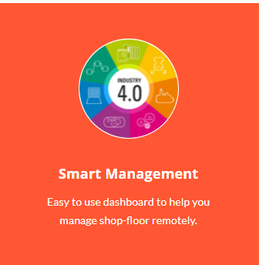
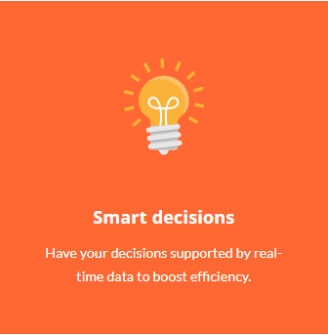
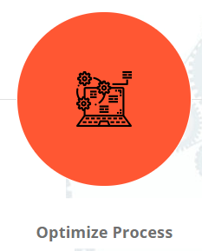
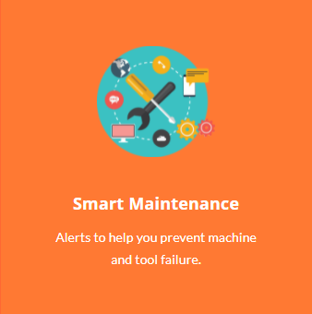
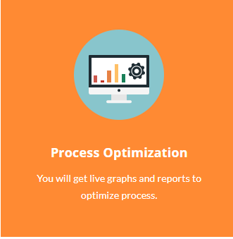

Introduction to Industrial IoT / Smart Systems

Slide 39
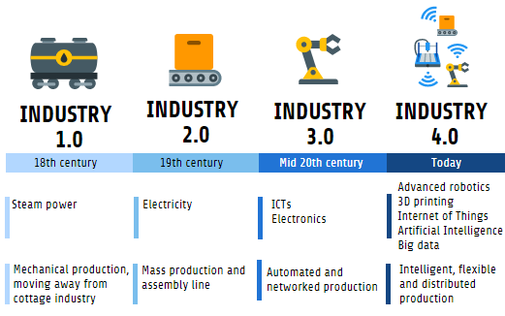

Slide 40
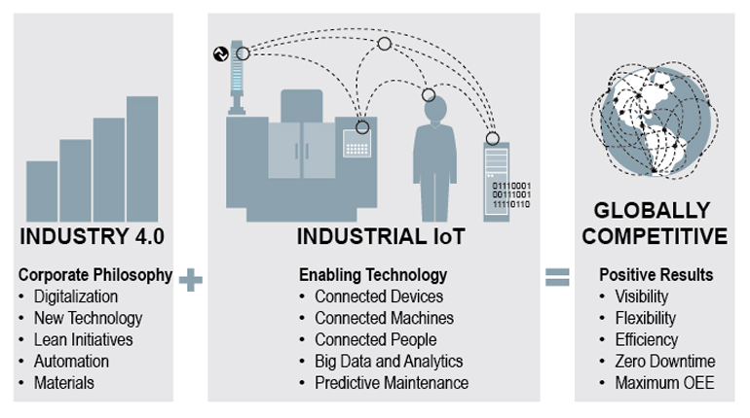

Slide 41
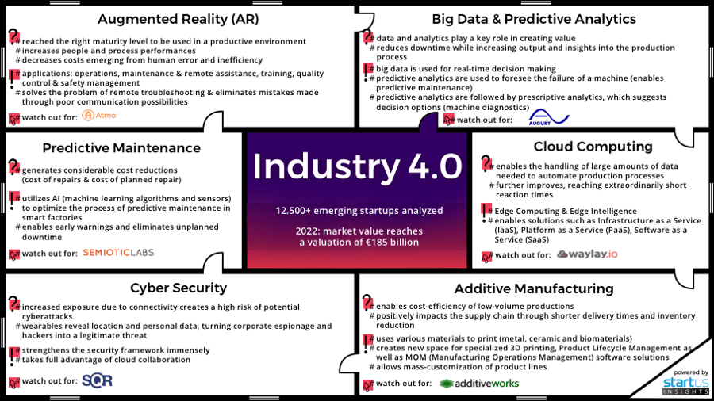

Slide 42
Smart Systems
Smart systems incorporate functions of sensing, actuation, and control in order to describe and analyze a situation, and make decisions based on the available data in a predictive or adaptive manner, thereby performing smart actions. ( Wiki )

Slide 43
Smart systems typically consist of diverse Components:
Sensors for signal acquisition
Elements transmitting the information to the command-and-control unit
Command-and-control units that take decisions and give instructions based on the available information
Components transmitting decisions and instructions
Actuators that perform or trigger the required action

Slide 44
Current generation smart systems: combine “technical intelligence” and “cognitive functions” so that they can provide an interface between the virtual and the physical world

Slide 45
Smart Systems and IoT are driven by a Combination of Sensors & Actuators , Connectivity, People and Processes

Slide 46
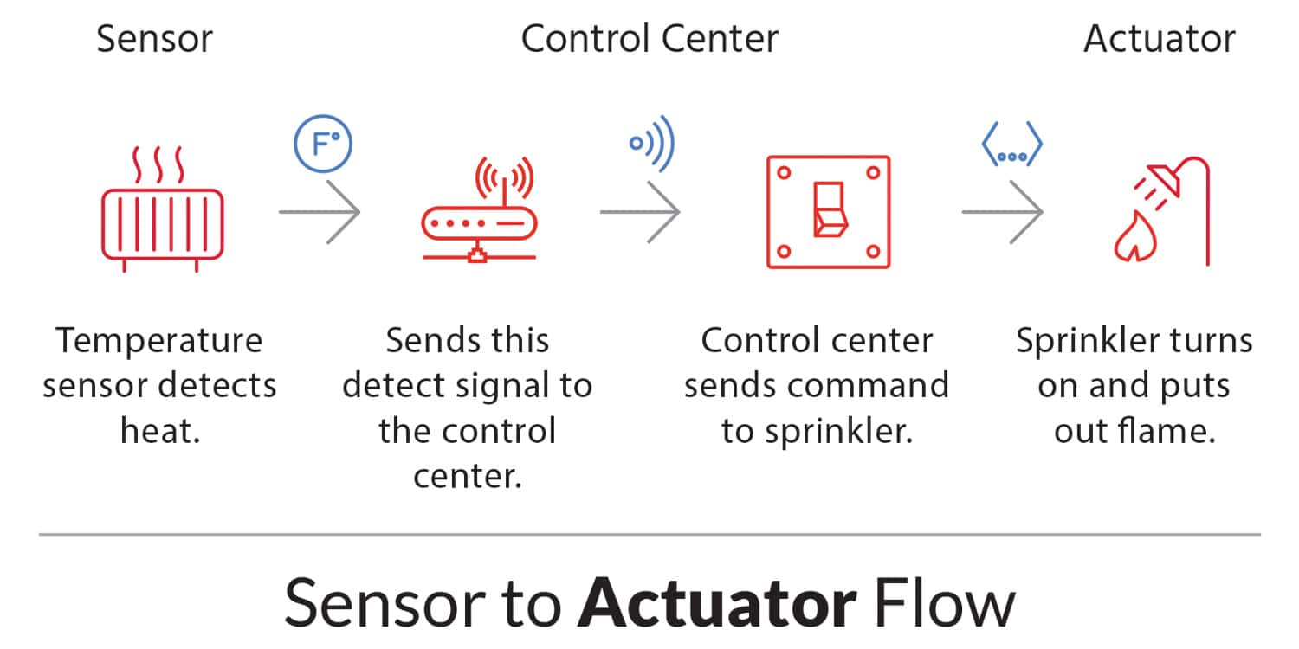

Slide 47
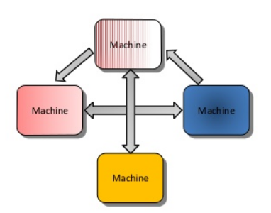
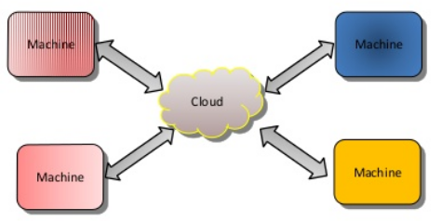
M2M vs IoT
Def: M2M is communicating among machines to manipulate content/data
M2M
IoT

Slide 48
2 C’s for M2M Content Connectivity
You need additional 4C’s for M2M to qualify as an IoT.

Slide 49
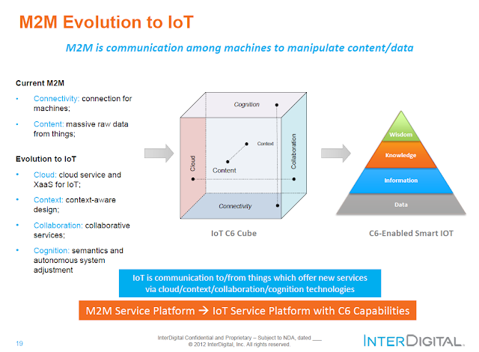

Slide 50
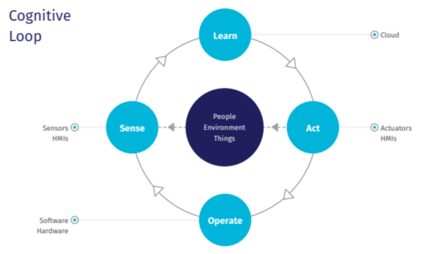
How to perceive and act in IoT?

Slide 51
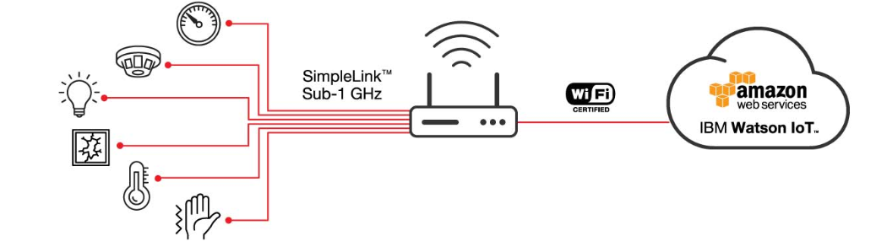
Smart Systems – Basic Setup

Slide 52
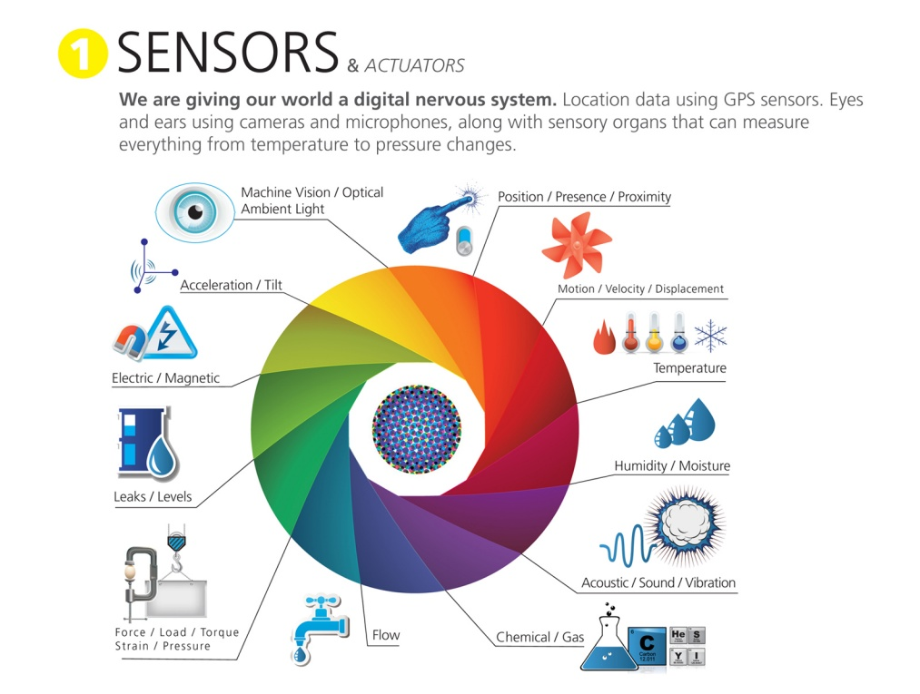

Slide 53
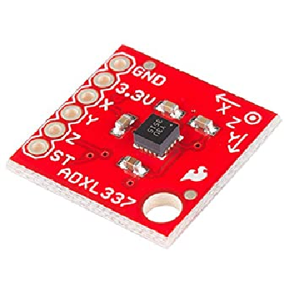
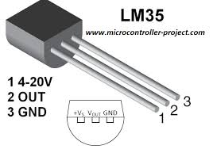
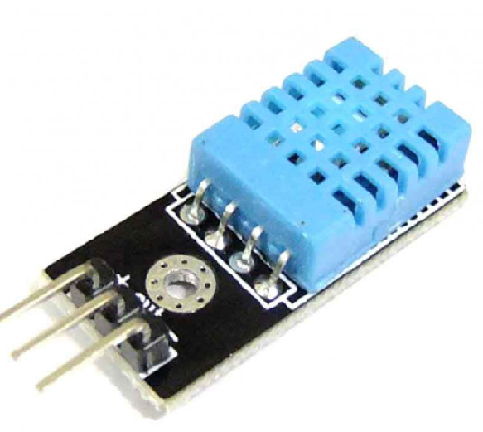
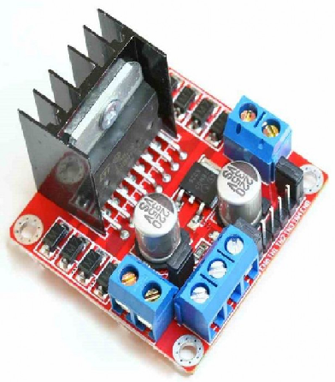
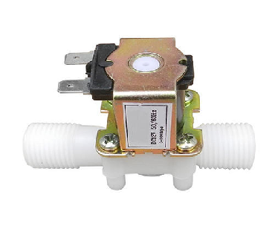
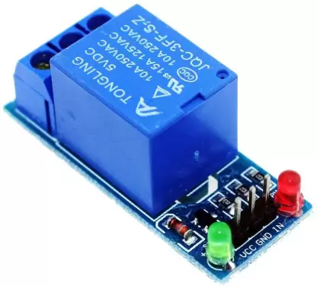
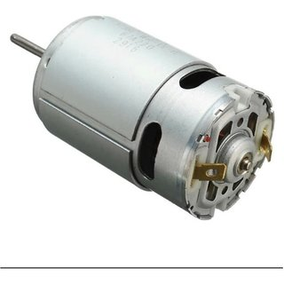
Temperature sensor
Accelerometer
DHT 11 - Sensor
Solenoid valve
Relay - Actuator
DC Motor with Driver

Slide 54
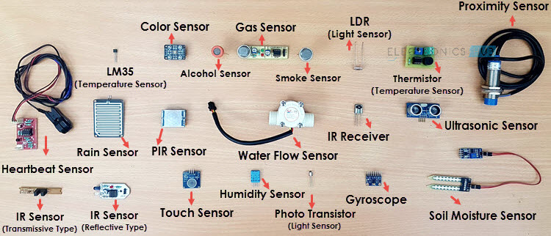

Slide 55
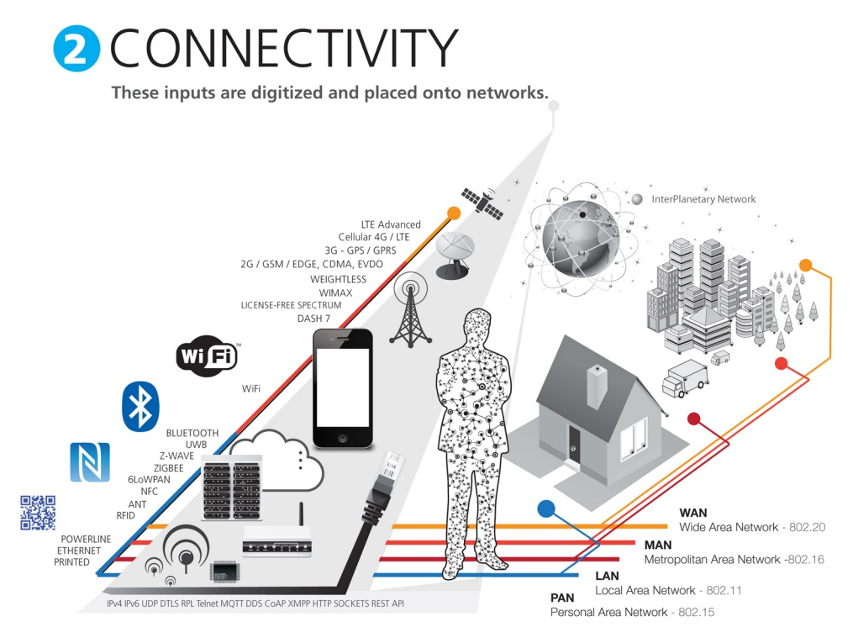

Slide 56
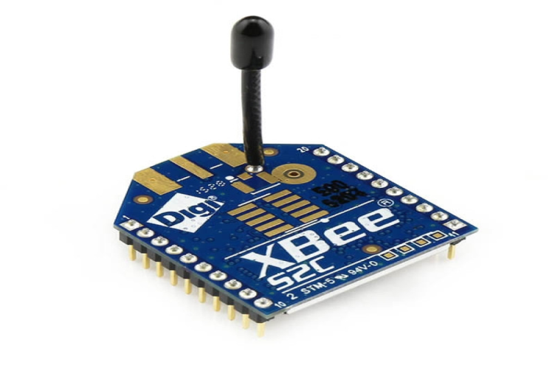
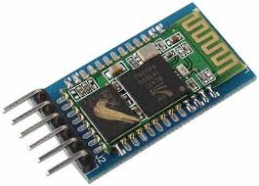
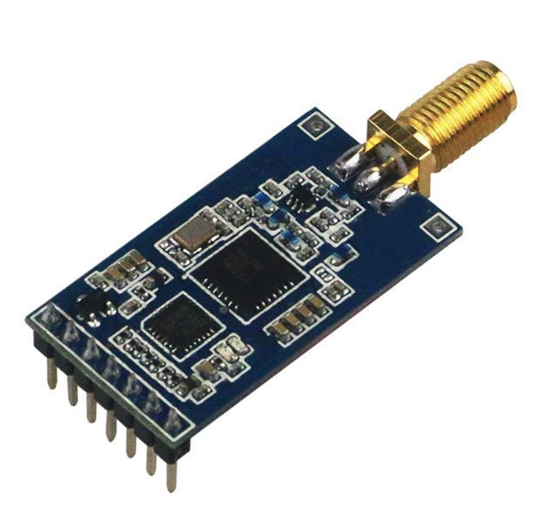
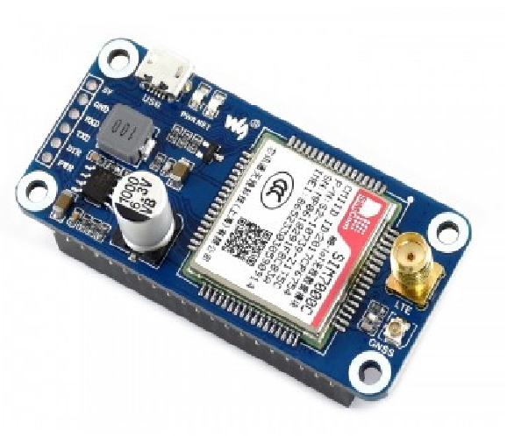
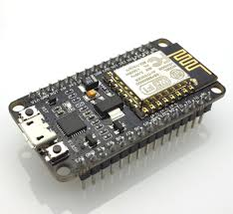
ZigBee
Bluetooth
Wi-fi
LoRa
NB IoT

Slide 57
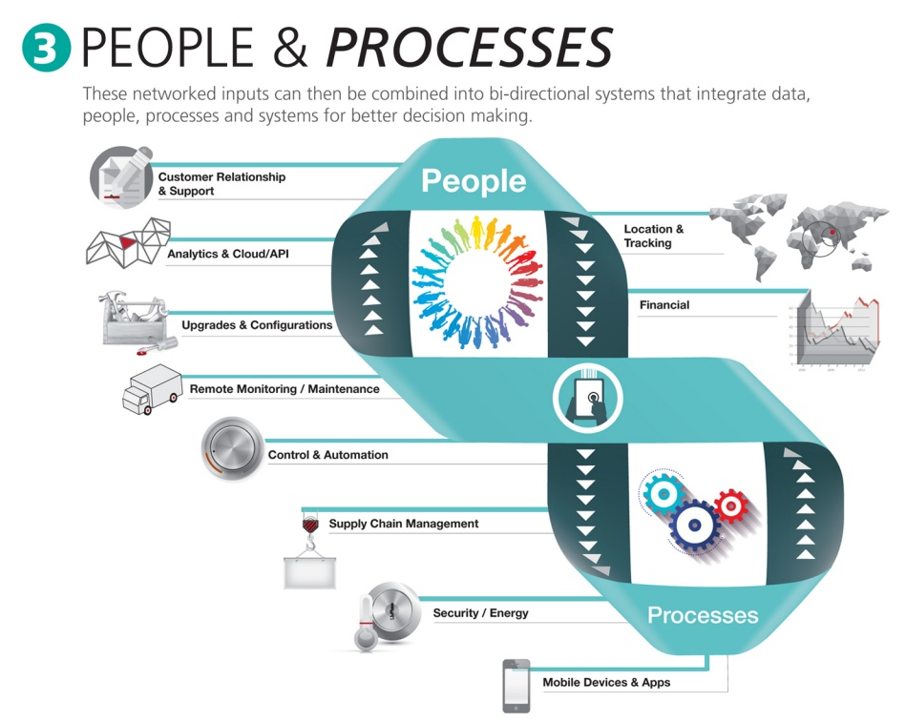

Slide 58
What are ‘Things’ in Internet?
‘Things’ are very various such as computers, sensors, people, actuators, refrigerators, TVs, vehicles, mobile phones, clothes, food, medicines, books, etc.
These things are classified as three scopes: people, machine (for example, sensor, actuator, etc.) and information (for example, clothes, food, medicine, books, etc.).
These ‘things’ should be identified at least by one unique way of identification for the capability of addressing and communicating with each other and verifying their identities.
In here, if the ‘thing’ is identified, we call it the ‘object.’

Slide 59
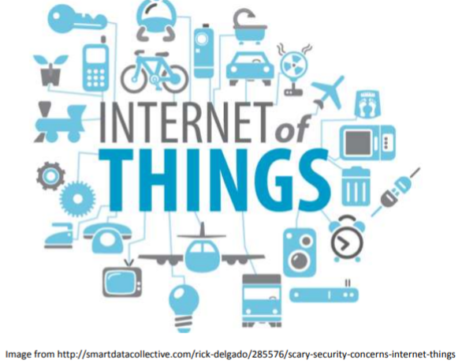
Why do we need IoT?
To receive more data
To control stuff
To automate
To make things faster

Slide 60
Growth of IoT
The Internet of Things (IoT) is a global industry movement that brings together people, process, data, and things to make networked connections more relevant and valuable than ever before.
A forecast by International Data Corporation (IDC) estimates that there will be 41.6 billion IoT devices in 2025, capable of generating 79.4 zettabytes (ZB) of data

Slide 61
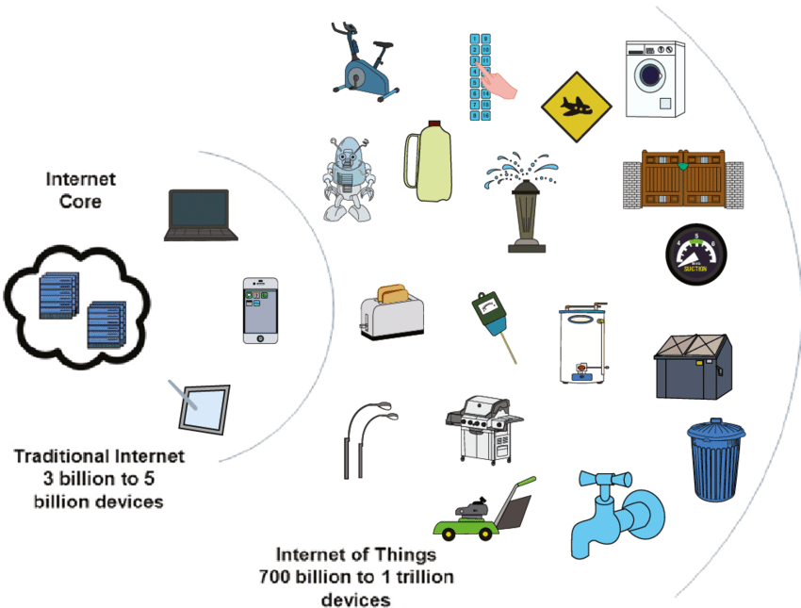
Impact of IoT
IoT has the power to change the way we interact with our belongings, and in an industry or enterprise, it can change the way the businesses run
Reference book: Francis Dacosta, Rethinking the Internet of Things, Intel Publications, 2013.

Slide 62
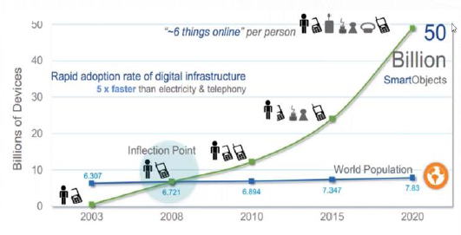
Impact of IoT
IoT has the power to change the way we interact with our belongings, and in an industry or enterprise, it can change the way the businesses run

Slide 63
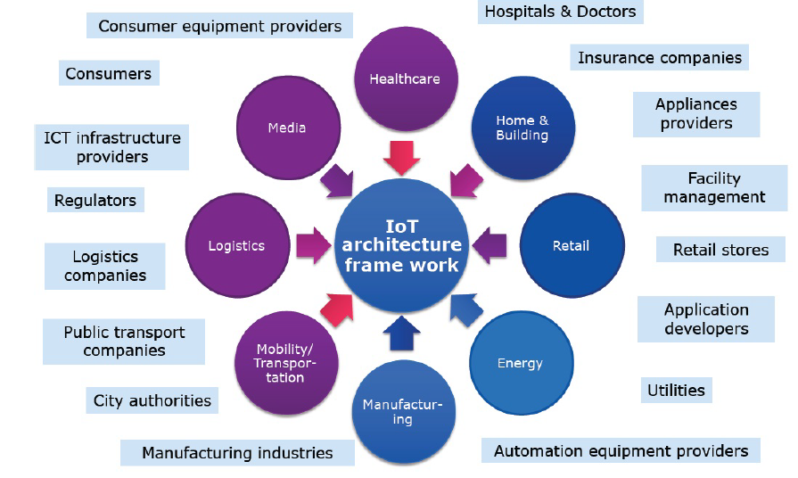
IoT Market and Stakeholders

Slide 64
The Application of IoT(1)
Regional Office
Biosensor taken by people
House
Network
Equipment in public place
Transportation Vehicle
Virtual Environment
Notes:
Application area should be divided by that two

Slide 65
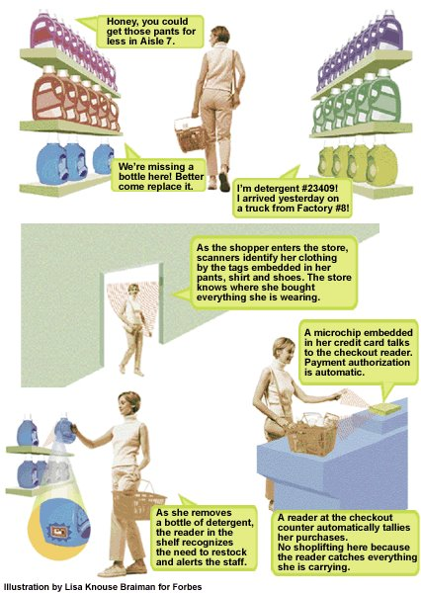
The Application of IoT(2)
Scenario: shopping
(2) When shopping in the market, the goods will introduce themselves.
(1) When entering the doors, scanners will identify the tags on her clothing.
(4) When paying for the goods, the microchip of the credit card will communicate with checkout reader.
(3) When moving the goods, the reader will tell the staff to put a new one.

Slide 66
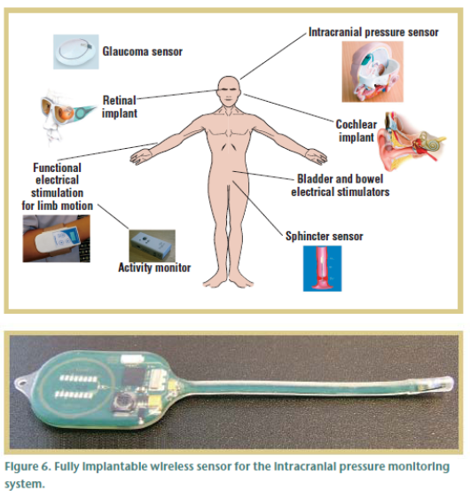
The Application of IoT(3)
Scenario: Health Care
Various sensors for various conditions
Example ICP sensor: Short or long term monitoring of pressure in the brain cavity
Implanted in the brain cavity and senses the increase of pressure
Sensor and associated electronics encapsulated in safe and biodegradable material
External RF reader powers the unit and receives the signal
Stability over 30 days so far
Notes:
New efficient diagnostics combined with nanotechnology enabled lab-on-a-chip technologies open a complete range of novel opportunities for new treatments and prevention of serious diseases. In-vivo equipment will assist in drug dosage closer to the affected organs thus reducing the amount of reagents needed and diminish the risk of adverse effects. It is an established fact that several serious common illnesses like breast cancer, cardio-vascular diseases and Alzheimer's disease have genetic components. It is also known that successful treatment depends on early detection.
Biodegradable materials will offer the possibility to place temporary sensors and lab-on-a-chip equipment on the patient, or in the patient. Temperature and humidity can be measured inside a cast to prevent skin problems. Antigens may be detected on transplanted organs to help prevent rejection. Intelligent micro-robots may be guided to bring drugs to the infected areas by ex-vivo remote guidance, and assist in the diagnosis providing located measurements of vital parameters.
Furthermore, this new sort of personal medical equipment will enable the patient to stay longer and safer at home since the equipment itself can alarm the hospital in case of critical situations, or the patient can be relieved from the hassle of routine checks when there is nothing wrong. Medical research will advance on data from patients living normal lives and not like guinea pigs in hospitals. Telemedicine may replace costly travel and reduce patient stress.

Slide 67
The Application of IoT(3)
Scenario: Health Care
National Health Information Network, Electronic Patient Record
Home care: monitoring and control
Pulse oximeters, blood glucose monitors, infusion pumps, accelerometers, …
Operating Room of the Future
Closed loop monitoring and control; multiple treatment stations, plug and play devices; robotic microsurgery
System coordination challenge
Progress in bioinformatics: gene, protein expression, systems biology, disease dynamics, control mechanisms

Slide 68
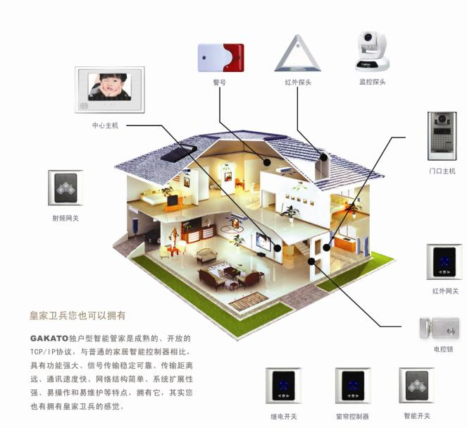
The Application of IoT(4)
Scenario: Intelligent Home
Remote monitor for smart house
Remote control for smart appliance
Notes:
Maintaining a comfort temperature and heating of water are the most energy consuming tasks of the house with huge potentials for energy conservation, and as a consequence a significant positive impact on the environment. This is further discussed under environmental aspects and resource efficiency below
There will be robots taking care of the house, performing routine works such as cleaning or maintenance. These will collaborate autonomously with the house sensors, and the house control. The intelligent appliances will collaborate to conserve energy, and to signal need for new supplies of food, detergents, maintenance, etc. Some of which may be satisfied automatically by the maintenance robot. This will take away some of today’s tedious housekeeping activities.

Slide 69
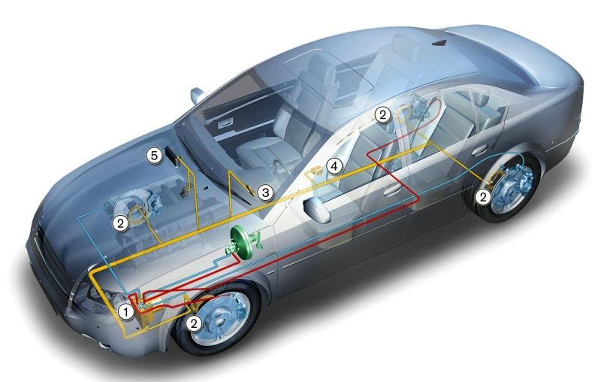
The Application of IoT(5)
Scenario: Transportation
A network of sensors set up throughout a vehicle can interact with its surroundings to provide valuable feedback on local roads, weather and traffic conditions to the car driver, enabling adaptive drive systems to respond accordingly
This may involve automatic activation of braking systems or speed control via fuel management systems. Condition and event detection sensors can activate systems to maintain driver and passenger comfort and safety through the use of airbags and seatbelt pre-tensioning
Sensors for fatigue and mood monitoring based on driving conditions, driver behaviour and facial indicators can interact
to ensure safe driving by activating warning systems
or directly controlling the vehicle
Notes:
When there is a queue, the first cars may tell the cars behind if there is an accident or just too much traffic, and this will eventually make intelligent navigation systems re-plan the route of cars programmed to go down already saturated roads. The cars may help the driver to keep safe distance to the car in front, and may refuse dangerous actions like speeding if the weather conditions are unsafe or overtaking if the oncoming car goes too fast. The cars can go by autopilot on highways reducing the risk of fatigue related accidents.
Cars will also be able to maintain themselves, calling for the appropriate service based on the self diagnosis of the problem and ensuring that the right replacement parts are in stock. The car will plan the time of service according to the diaries and preferences of the usual driver to minimise the petulance of their lives, and make sure that there is a substitute car available if there would be a need for it.

Slide 70
The Application of IoT(5)
Scenario: Transportation
In 2005, 30 – 90 processors per car
Engine control, Break system, Airbag deployment system
Windshield wiper, Door locks, Entertainment system
Cars are sensors and actuators in V2V networks
Active networked safety alerts
Autonomous navigation
Future Transportation Systems
Incorporate both single person and mass transportation vehicles, air and ground transportations.
Achieve efficiency, safety, stability using real-time control and optimization.

Slide 71
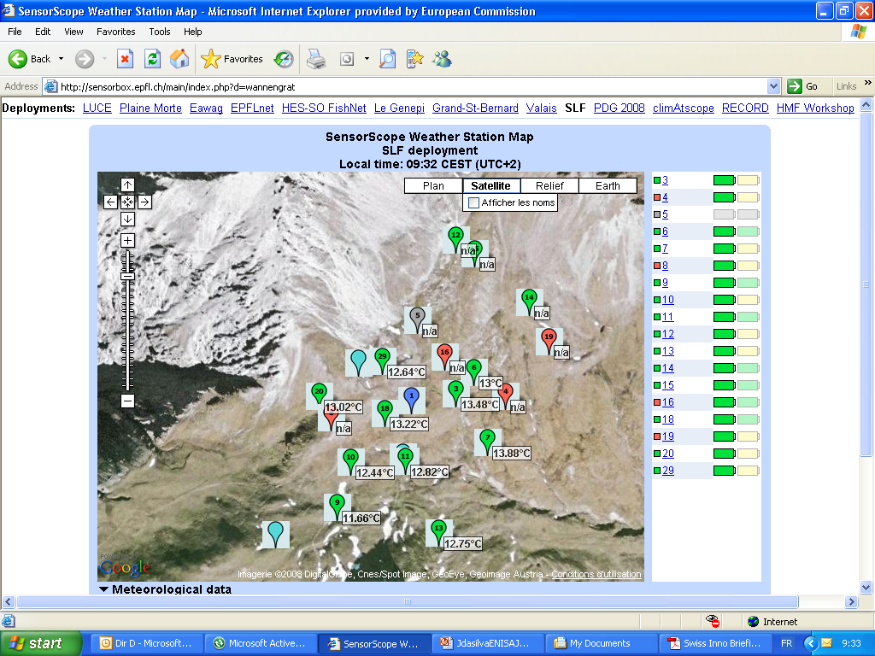
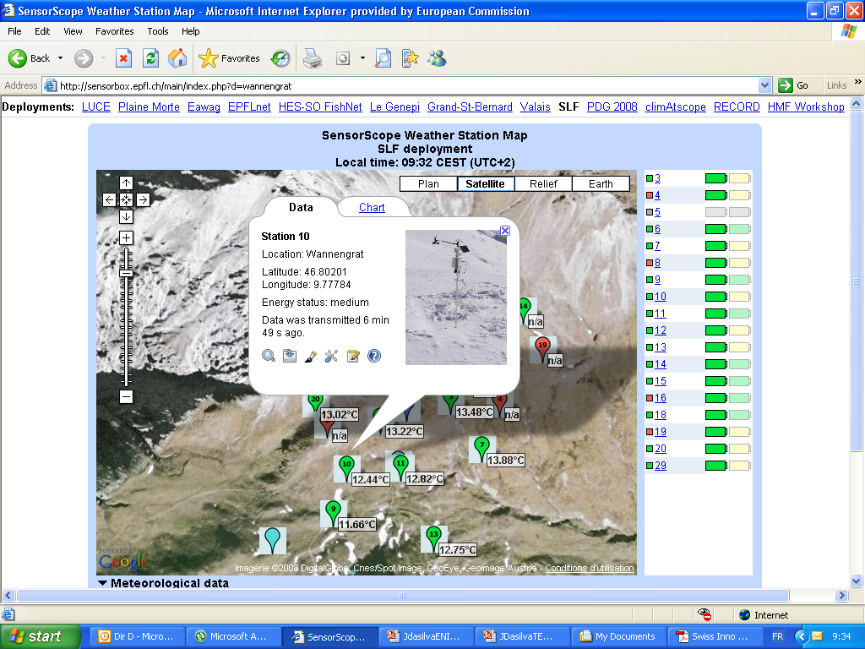
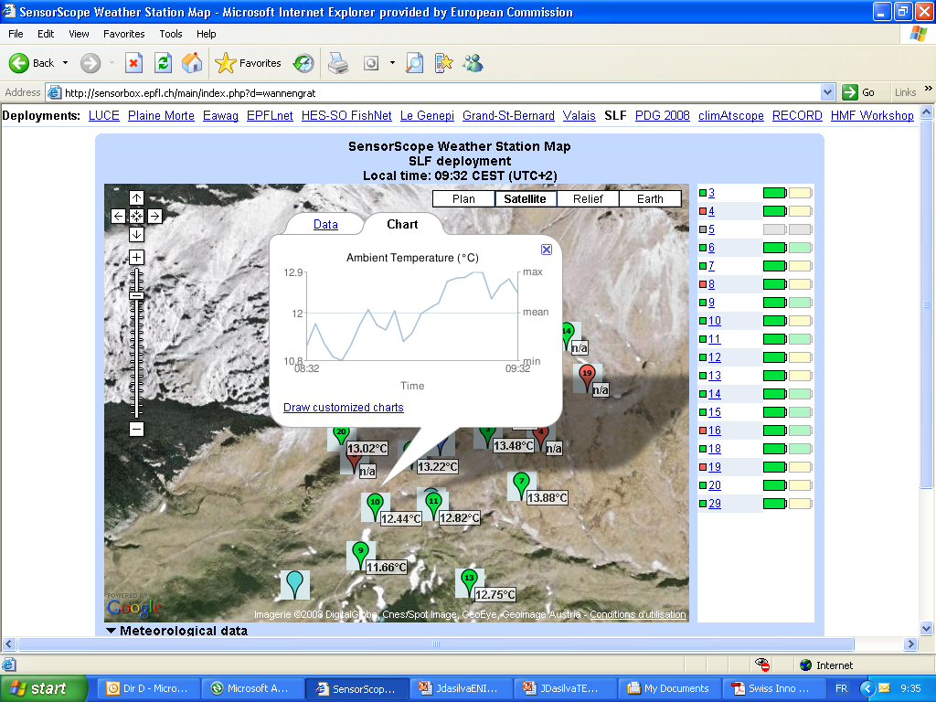
Scenario : Monitoring the Environment
The Application of IoT(6)

Slide 72
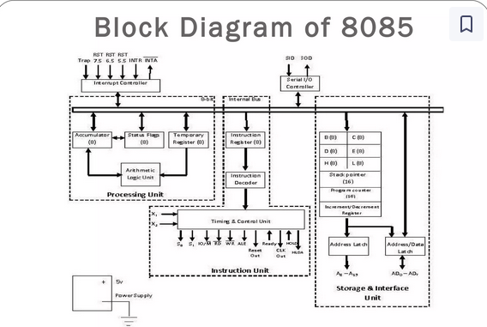

Slide 73
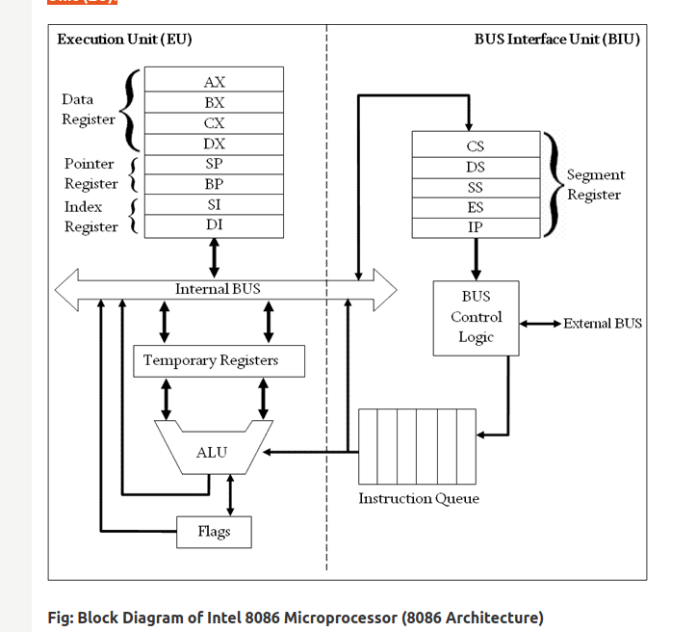

Slide 74
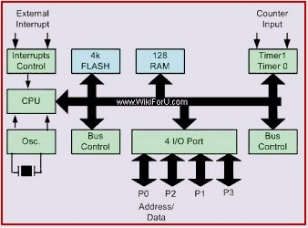
Block diagram of 8051 Mc

Slide 75
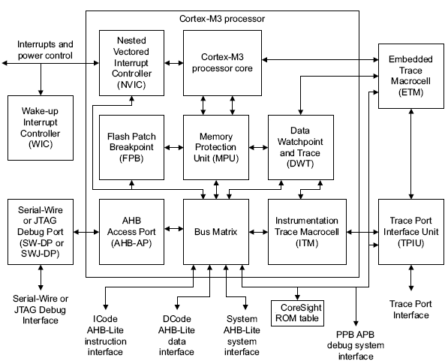

Slide 76
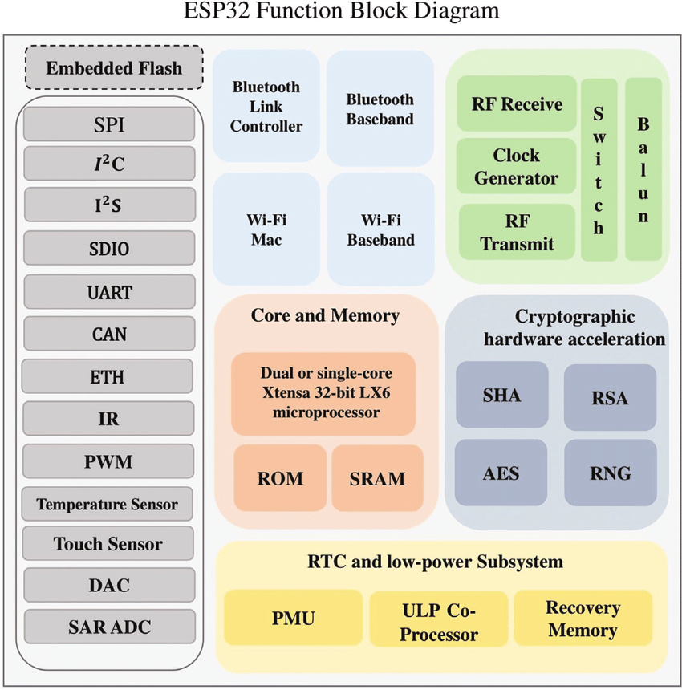

Slide 77
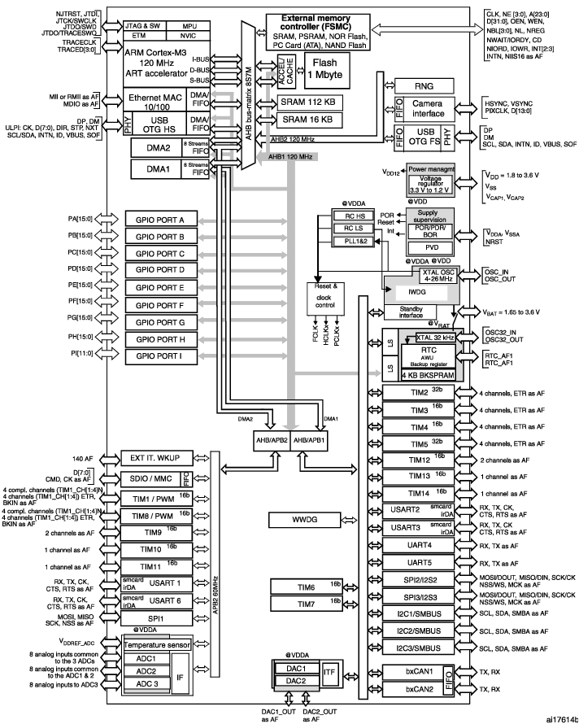

Slide 78
ESP 32

Slide 79
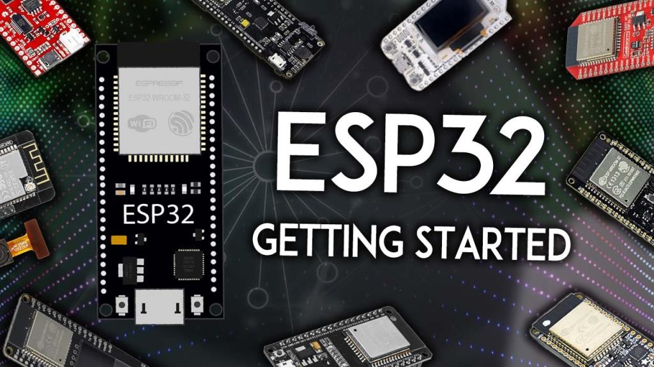
ESP32

Slide 80
Why ESP32
The ESP32 is a series of chip microcontrollers developed by Espressif.
Low-cost: 6$
Low-power: Supports mode states like deep sleep
Wi-Fi capabilities: station mode or access point mode)
Bluetooth: Bluetooth classic and Bluetooth Low Energy (BLE)
Dual-core: most ESP32 are dual-core - 2 Xtensa 32-bit LX6 microprocessors: core 0 and core 1.
Rich peripheral input/output interface - ADCs, DACs, UART, SPI, I2C, PWM, etc.
Compatible with the Arduino “programming language”
Compatible with MicroPython

Slide 81
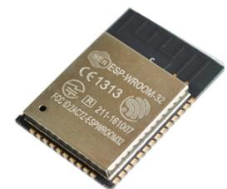
ESP32 Specifications
Wireless connectivityWiFi: 150.0 Mbps data rate with HT40
Bluetooth: BLE (Bluetooth Low Energy) and Bluetooth Classic
Processor: Tensilica Xtensa Dual-Core 32-bit LX6 microprocessor, running at 160 or 240 MHz
Memory:
ROM: 448 KB (for booting and core functions)
SRAM: 520 KB (for data and instructions)
RTC fast SRAM: 8 KB (for data storage and main CPU during RTC Boot from the deep-sleep mode)
RTC slow SRAM: 8KB (for co-processor accessing during deep-sleep mode)
eFuse: 1 Kbit (of which 256 bits are used for the system (MAC address and chip configuration) and the remaining 768 bits are reserved for customer applications, including Flash-Encryption and Chip-ID)
Embedded flash: flash connected internally via IO16, IO17, SD_CMD, SD_CLK, SD_DATA_0 and SD_DATA_1 on ESP32-D2WD and ESP32-PICO-D4.
0 MiB (ESP32-D0WDQ6, ESP32-D0WD, and ESP32-S0WD chips)
2 MiB (ESP32-D2WD chip)
4 MiB (ESP32-PICO-D4 SiP module)
Low Power: ensures that you can still use ADC conversions, for example, during deep sleep.
Peripheral Input/Output:
peripheral interface with DMA that includes capacitive touch
ADCs (Analog-to-Digital Converter)
DACs (Digital-to-Analog Converter)
I²C (Inter-Integrated Circuit)
UART (Universal Asynchronous Receiver/Transmitter)
SPI (Serial Peripheral Interface)
I²S (Integrated Interchip Sound)
RMII (Reduced Media-Independent Interface)
PWM (Pulse-Width Modulation)
Security: hardware accelerators for AES and SSL/TLS

Slide 82
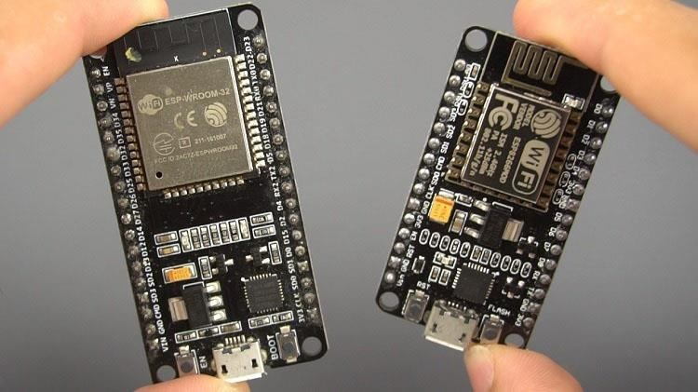
ESP32 Vs ESP8266

Slide 83
ESP32 and ESP8266
The ESP32 is faster than the ESP8266
The ESP32 comes with more GPIOs with multiple functions
Touch-sensitive pins - to wake up the ESP32 from deep sleep
The ESP32 supports analog measurements on 12 Bit 18/15 channels versus just one 10-bit ADC pin on the ESP8266
The ESP32 supports Bluetooth while the ESP8266 doesn’t
The ESP32 is dual-core (most models), and the ESP8266 is single core
The ESP32 is a bit more expensive than the ESP8266.

Slide 84

ESP32 Development Boards

Slide 85


ESP32 DEVKIT - DOIT
36 Pins
30 Pins

Slide 86

Specifications – DOIT ESP32 DEVKIT V1

Slide 87

Board Layout

Slide 88


ESP32 GPIOs Pinout
36 Pins
30 Pins

Slide 89

GPIO Pins

Slide 90



Which ESP32 GPIOs are safe to use?

Slide 91


Which ESP32 GPIOs are safe to use?

Slide 92

Which ESP32 GPIOs are safe to use?

Slide 93

ADC Pins

Slide 94

DAC Pins

Slide 95

Touch Pins

Slide 96

UART Pins

Slide 97

I2C Pins

Slide 98

SPI Pins

Slide 99

PWM Pins

Slide 100

Power Pins

Slide 101

On Board LED @ GPIO 2 & Boot Button @ GPIO 0

Slide 102

Enable Pin

Slide 103
List of Embedded companies
1. Delphi automotive
2. Visteon Corporation
3. John Deere India pvt ltd
4. Robert Bosch engineering and business solutions limited
5. Caterpillar India
6. General Motors
7. Cisco Systems India Pvt Ltd
8. Ashok Leyland
9. L&T InfoTech
10. Honeywell India
11. Wipro Technologies
12. HCL Technologies
13. KPIT Cummins Info systems
14. Siemens
15. Tata Elxsi
16. Rockwell well India
17. ETAS automotive
18. EMC corporation India
19. Sasken communication technologies ltd
20. Infosys
21. Renault Nissan Automotive India Private Limited
22. mistral solutions
23. Robosoft systems
24. Vista infosystems Chennai
25. Automotive Infotronics
27. Jasmin Infotech Private Limited
28. Dexcel Designs
29. SMSC
30. Einfochips and so on...

Slide 104


Slide 105
Embedded Software Engineer requirements and qualifications
X years of experience in embedded software engineering or similar role
BS degree in Computer Science or Engineering
X years of experience with development and troubleshooting on embedded targets
Good programming experience in C or C++
Familiarity with software configuration management tools, defect tracking tools, and peer review
Excellent knowledge of OS coding techniques
Knowledge of different IP protocols, interfaces and hardware subsystems
Sense of ownership and pride in your performance and its impact on company’s success
Critical thinker and problem-solving skills
Team player
Good time-management skills
Great interpersonal and communication skills

Slide 106
SCHEDULE OF EMBEDDED SYSTEM AND IOT COURSE
DATE | DAYS | TOPICS | THEORY | PRACTICAL | TOTAL HRS
 | 15 | C Programming | 15 | 15 | 30
 | 10 | C++ Programming | 8 | 12 | 20
 | 5 | Linux Fundamentals | 5 | 5 | 10
 | 5 | Basic Electronics | 10 | 0 | 10
 | 10 | Introduction to Embedded C | 10 | 10 | 20
 | 4 | Introduction to Embedded Systems | 4 | 4 | 8
 | 3 | Embedded C and Keil , Arduino IDE | 2 | 4 | 6
 | 3 | ESP32 Introduction and Architecture | 2 | 4 | 6
 | 5 | Introduction to Bare metal Embedded C Program (ESP32) | 4 | 6 | 10
 | 10 | Programming ESP 32 Peripherals (GPIO, Timers, Serial Port) | 4 | 16 | 20
 | 10 | Interfacing external peripherals to ESP 32 Based Microcontroller Board | 4 | 16 | 20
 | 5 | ARM /Cortex Introduction and Architecture | 4 | 6 | 10
 | 5 | Introduction to Bare metal Embedded C Program (STM32) | 4 | 6 | 10
 | 10 | Programming ARM Cortex Peripherals (GPIO, Timers, Serial Port) | 4 | 16 | 20
 | 10 | Interfacing external peripherals to ARM Based Microcontroller Board | 4 | 16 | 20
 | 110 | TOTAL | 84 | 136 | 220

Slide 107


Slide 108
The class continues……

Slide 109
Presented by P.SABARI MANI, MOBILE- 9894947320. E-MAIL. smrajlaks75@gmail.com

